Slide 1





Momentum Investing
Project By:
Weijie Cao, Shirley Duan, Haoyang Shang, Zhengwu Zhu

Slide 2

Contents
01
02
03
04
05
06
About Momentum Investing
Data Collection
Data Cleaning
Model Implementation
Model Validation
Summary & Improvement

Slide 3

01
About Momentum Investing

Slide 4

About Momentum Investing
Compare & Rank Historical Performance
Purchase winner stocks
Short past loser stocks
Jegadeesh and Titman, 1993
Notes:
Momentum investing is a well-known trading strategy that suggests investors first compare and rank the historical performances among various stocks, then purchase the past winner stocks and short the past loser stocks to maximize their profits. In 1993, Jegadeesh and Titman(1993) used this strategy and generated significant positive returns over 3- to 12-month holding periods. In our project, we will use Python to replicate this system and backtest it to see whether momentum investing is a robust trading strategy or not.

Slide 5

Two Critical Points
Length of Lookback window
Portfolio Holding period (requires appropriate rebalance)

Slide 6

02
Data Collection

Slide 7
Main Data we need:
Historical stock price, daily.
S&P500 stock tickers
To avoid potential Survivor Bias: We cannot pick current S&P500 stocks as our testing universe and trace them back.
Many stocks could be delisted.
Randomly choose 100 tickers to construct our testing universe at spot time
Focus on the testing universe so that we are not affected by the change of S&P500 tickers.
Data source: yfinance.
Why? Adjusted Close Price, reflecting value change due to corporate action
Some trust issue: We have detected extreme value of stock price, might be caused by misplaced decimal points.

Slide 8

03
Data Cleaning

Slide 9
Data cleaning
Filtration:
Set up minimum stock price ($10) to filter out penny stock (strong momentum signal caused by little price change)
Delisted stock would cause null values of stock price:
Using last good value to fill the null value.
Modify momentum signal, choosing stocks with positive signal to
avoid such issue. (Equal value will be zero changes.)

Slide 10

04
Model Implementation

Slide 11
Time to put the model into the test!
3 Sample periods: 2011-2012, 2014-2015, 2018-2019
8 different strategies each with different lookback window and holding period

Slide 12
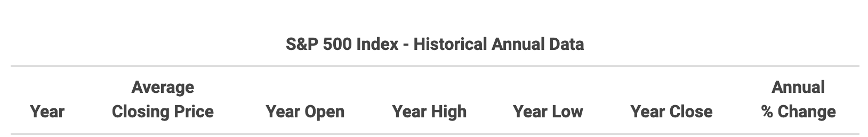
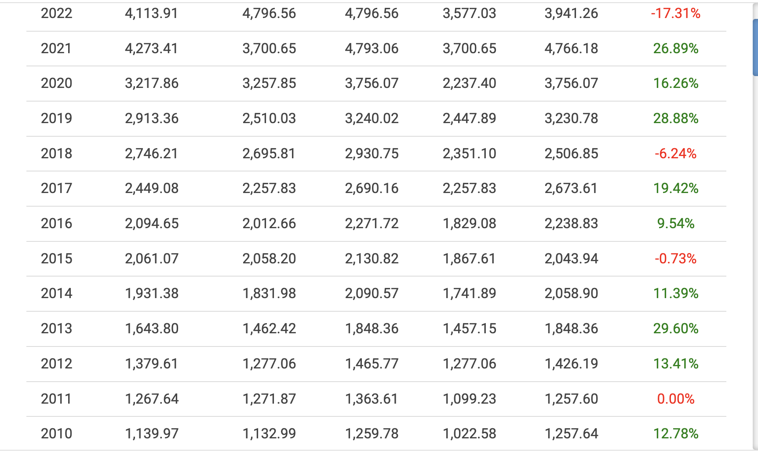

Slide 13

05
Model Validation

Slide 14
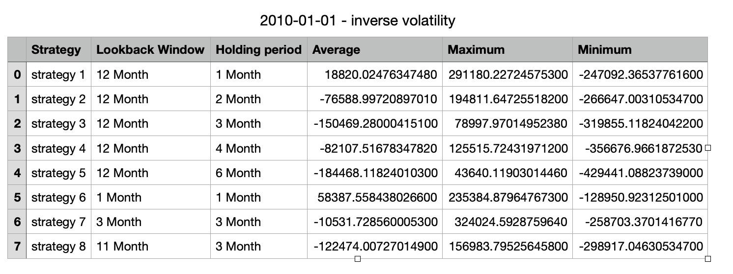
Year 2011, SP500 had almost 0% yearly return. 1-Y treasury has 0.18% yield. Our portfolio with 1 Million invested has following returns over 30 trials.

Slide 15
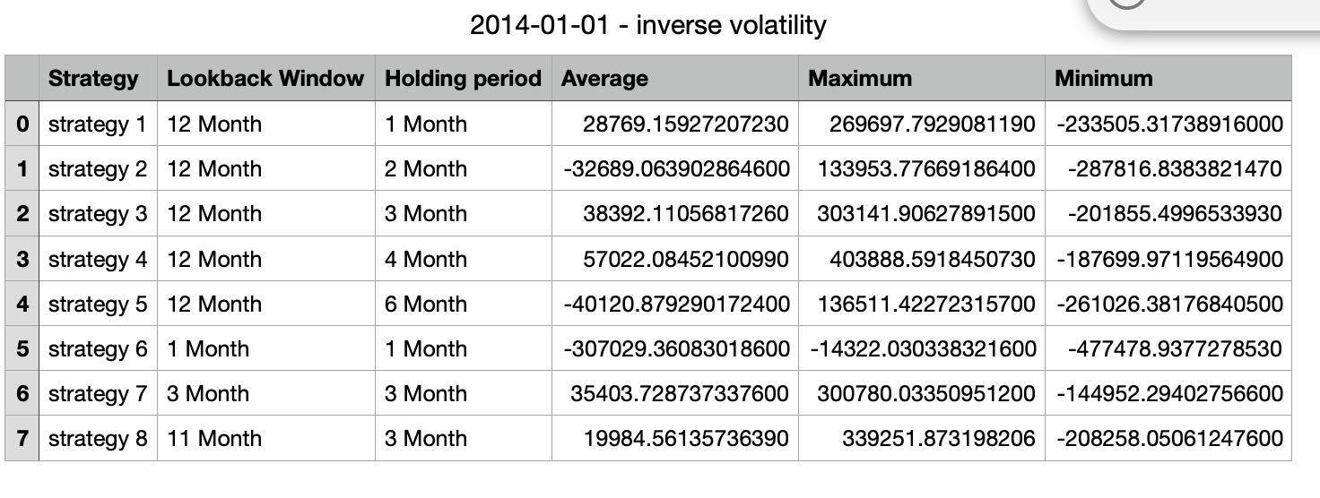
Year 2015, SP500 had -0.73% return. 1-Y treasure had 0.32% yield.

Slide 16

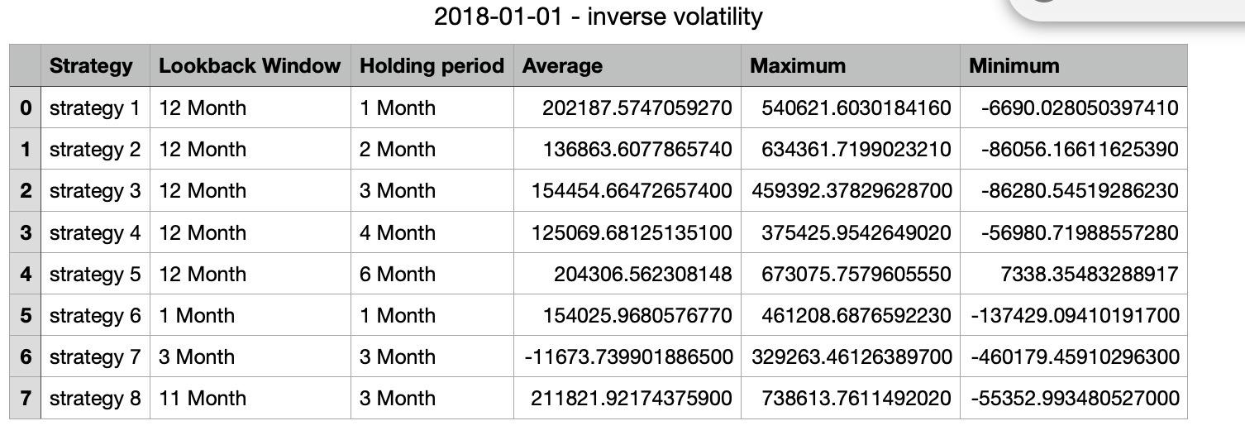
Year 2019, SP500 grew 28.88%, 1-Y treasure had 2.05% yield, due to macro fiscal/monetary policies

Slide 17
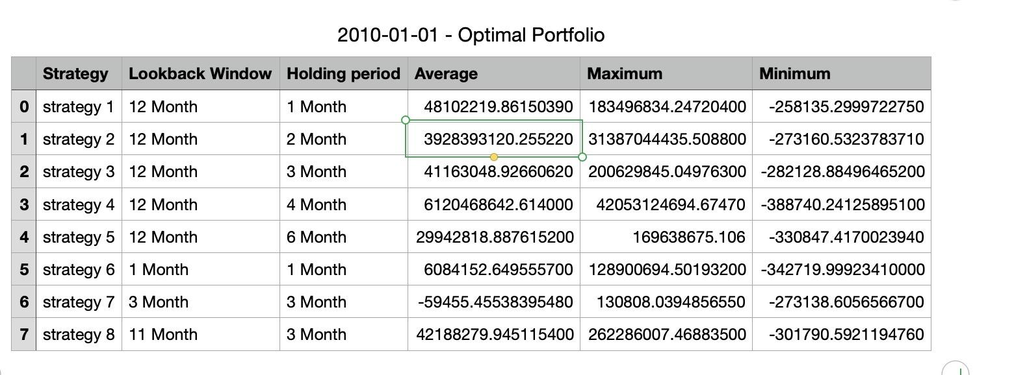
In other years, our model beat SP500 return by 1%-15%. Three weight distributions behave similarly for the 3 time periods, except…
How did 4 billion dollar return happen?

Slide 18
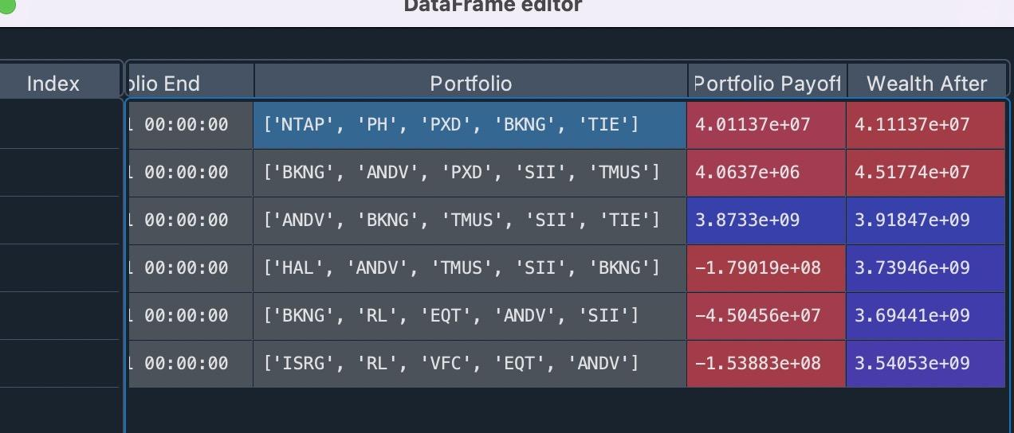
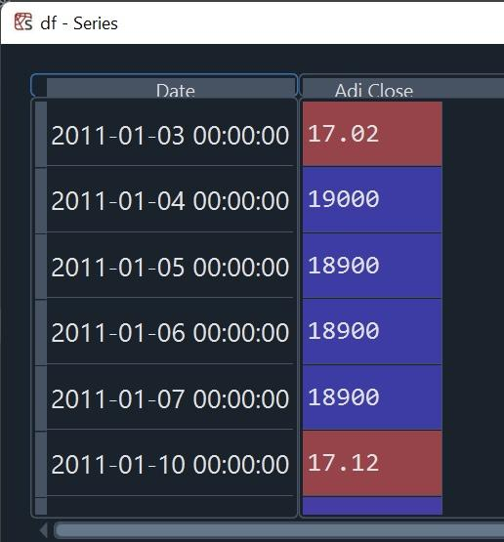
TIE seems a lil
fishy…

Slide 19

06
Summary & Improvement

Slide 20
Summary
filter
Initial date
S&P 500 companies
100 tickers (tracking universe)
Model
Rebalance, go back to the model, find 5 new stocks
(Lookback window)
Sell those 5 stocks
5 stocks with highest momentum (weight)
Hold
(holding period)

Slide 21
Conclusions
In different year, performance of the same strategy can vary.
In most of the time, longer lookback window works better than shorter lookback window.
Different weighting strategies have limited impact on portfolio payoff.
Strategy with 12-month lookback window and 1-month holding period is the most stable strategy.
When we fix the holding period to 3 months, the 11-month lookback window always works better than 12-month lookback window. (Reversal Effect in the recent month)

Slide 22

Future Improvements
Shirley
“Let’s add short position next time!”
Weijie
“To enhance the diversity of our portfolio, we can add sector filter next time. ”
“ Does hourly momentum have enough potential to be carried into high-frequency trading in milliseconds?”
Haoyang
Regan
“We need more reliable source next time. ”

Slide 23


Slide 24

Thanks
for listening!

Slide 25
Reference
1. Asness, Clifford S., et al. “Value and Momentum Everywhere.” The Journal of Finance (New York), vol. 68, no. 3, 2013, pp. 929–985.
2. fja05680. “FJA05680/SP500: Current and Historical Lists of S&P 500 Components since 1996.” GitHub, https://github.com/fja05680/sp500.
3. Jack Vogel, PhD. “How to Measure Momentum?” Alpha Architect, 10 May 2022, https://alphaarchitect.com/2016/10/how-to-measure-momentum/.
4. Jegadeesh, N. “EVIDENCE OF PREDICTABLE BEHAVIOR OF SECURITY RETURNS.” The Journal of Finance (New York), vol. 45, no. 3, 1990, pp. 881–898.
5. Jegadeesh, Narasimhan, and Sheridan Titman. “Returns to Buying Winners and Selling Losers: Implications for Stock Market Efficiency.” The Journal of Finance, vol. 48, no. 1, 1993, pp. 65–91. JSTOR, https://doi.org/10.2307/2328882. Accessed 12 Oct. 2022.
6. Lehmann, Bn. “Fads, Martingales, and Market Efficiency.” The Quarterly Journal of Economics, vol. 105, no. 1, 1990, pp. 1–28.
7. “Momentum Portfolios.” Varsity by Zerodha, 12 July 2019, https://zerodha.com/varsity/chapter/momentum-portfolios/.

